Slide 1


Slide 2


Centre for Fire, Explosive and Environment Safety Training
This report details the development of a web portal for tracking and managing seminar applications within the Centre for Fire, Explosive, and Environment Safety (CFEES), a premier Indian defense laboratory under the Defence Research and Development Organisation (DRDO). The project was undertaken as a summer training program from May 20 to June 30, 2024, under the guidance of Ms. Mamta Meena, Scientist 'D'.

Slide 3

Company Profile
History
Areas of Work
Established in 1992, the Centre for Explosive and Environment Safety (CEES) was formed by merging three DRDO entities: the DRDO Computer Centre, Delhi, the Directorate of Explosives Safety, DRDO HQ, and the Fire Adviser's Office, DRDO HQ. In 2000, the Defence Institute of Fire Research (DIFR) was also integrated into CEES. Recognizing the crucial role of fire science, the Government of India renamed CEES to CFEES in 2003 to better reflect its expanded focus.
CFEES is actively involved in research and development across three key areas: Explosive Safety, Environmental Safety, and Fire Safety. Beyond technology development, CFEES also provides training and enforces safety standards in handling hazardous materials, including toxic, explosive, and flammable substances. The organization is also at the forefront of designing and developing sensors for threat detection.
Vision
Mission
To evolve into a Centre of Excellence in Fire Science & Engineering, Explosive, and Environmental Safety, providing integrated safety advice and services to Ministry of Defence (MoD) establishments.
Conducting cutting-edge R&D in Fire Science & Engineering, Explosive, and Environmental Safety. Serving as the Regulatory Authority for Fire, Explosive, and Environmental Safety within MoD establishments. Acting as the Nodal Agency for the implementation of Safety, Health, and Environment (SHE) policies and Disaster Management for DRDO.

Slide 4


Introduction to the Training Project
1
Objective
The objective of this training project was to develop a web portal for tracking and managing seminar applications within the company. The system is designed to streamline the submission, review, and approval process for applications, ensuring efficiency and transparency.
2
Scope
The scope of the project includes: Designing a user-friendly interface for application submission. Creating a dashboard for users at different levels to review and approve/reject applications. Implementing a tracking mechanism for applicants to check the status of their submissions.
3
Project Goals
Efficiency: Reduce the time and effort required to manage seminar applications. Transparency: Provide a clear and accessible tracking system for applicants. Scalability: Ensure the system can handle a large number of applications and users.

Slide 5


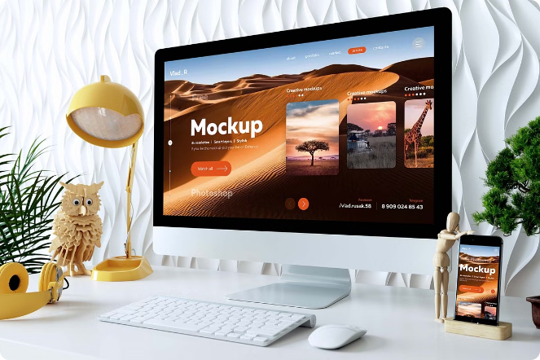
Abstract: Online HRD
The Online HRD is a comprehensive web-based application designed to streamline and automate various administrative tasks within the HR division of an organization. Developed over several weeks by a dedicated team of three, the project aimed to reduce paperwork and enhance efficiency in managing requests related to employee attendance at conferences and symposiums. Key functionalities implemented include a robust backend system for managing and storing course details, allowing HR administrators to add, edit, and delete upcoming events easily. The system features a user-friendly dashboard where employees can view upcoming courses, facilitating informed decision-making regarding their participation. In addition to course management and reporting, the project incorporated a feedback submission mechanism for conference attendees. This feature allows participants to submit their feedback directly through the system, which is then aggregated and displayed for HR review. Such real-time feedback mechanisms enhance organizational responsiveness and improve the overall participant experience. User training and documentation will also be prioritized to ensure effective utilization of the system across all organizational levels.

Slide 6
System Architecture
The system is designed using a three-tier architecture: the Presentation Layer, the Business Logic Layer, and the Data Layer.
Presentation Layer
Business Logic Layer
Data Layer
The user interface, which includes web pages built with HTML, CSS, and JavaScript.
The server-side scripting, implemented using PHP, which handles application logic and database interactions.
The database, managed using MySQL, which stores application data and user information.

Slide 7
Project Description
Requirement Analysis
1
This stage involved understanding the needs of the users and defining the functionalities required for the system. Meetings were held with stakeholders to gather requirements and create detailed specifications.
2
System Design
Based on the requirements, a system design was created. This included defining the system architecture, database schema, and user interfaces. Wireframes and mockups were created to visualize the user interfaces.
Development
3
During the development stage, the system was built according to the design specifications. The development process was divided into several iterations, with each iteration focusing on a specific module or functionality.
4
Testing
The system was rigorously tested to ensure it met the requirements and was free of bugs. Testing involved unit testing, integration testing, and user acceptance testing. Feedback from users was incorporated to improve the system.
Deployment
5
Once the system was thoroughly tested and approved, it was deployed to a production environment. Training sessions were conducted to familiarize users with the new system, and support was provided to address any issues that arose.

Slide 8



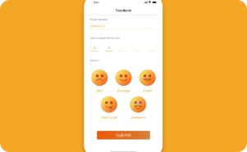
Core Functionalities of the System
The core functionalities of the system are divided into several modules, each serving a specific purpose. These modules work together to provide a seamless experience for users.
Application Submission
Dashboard
Inbox
Feedback
The dashboard provides an overview of user activities and links to other functionalities. It displays user-specific information, such as recent applications, messages, and notifications. It serves as the main interface for users to navigate the system.
The inbox displays messages and notifications to users. Users can view, delete, or respond to messages. This module ensures that users stay informed about the status of their applications and receive important updates.
The feedback module allows users to submit and view feedback. Users can provide feedback on the application process or the seminars they have attended. This feedback is stored in the database and can be viewed by administrators.
This module allows users to submit new applications for seminars, workshops, and conferences. Users can fill out a form with the necessary details, such as the seminar title, description, date, and other relevant information.

Slide 9







Code File Explanations
Dashboard
The dashboard serves as the main user interface where users can see an overview of their activities. It provides quick access to various functionalities like submitting new applications, checking the status of existing applications, and providing feedback. The dashboard is designed to be user-friendly and informative, ensuring that users can easily navigate and perform their tasks efficiently.
Inbox
The inbox displays messages and notifications to users. It is an essential part of the communication system within the portal, allowing users to stay informed about the status of their applications and receive important updates from reviewers and administrators. Users can read, delete, or respond to messages, ensuring effective communication.
Feedback
The feedback module allows users to provide feedback on their experiences with the application process or the seminars they have attended. This feedback is valuable for administrators to understand user experiences and make necessary improvements. Users can also view the feedback they have submitted.
Status Tracking
The status module allows users to track the progress of their submitted applications. It provides real-time updates on the status, such as pending, approved, or rejected, and any feedback provided by reviewers. This transparency ensures that users are always aware of the current state of their applications.
Upload Training
The upload training module enables administrators to upload details of upcoming training sessions, seminars, and workshops. This information is then made available to users, who can view and register for these events. The module includes forms for entering details like title, description, and date of the training.
View Training
The view training module allows users to view the details of the trainings they have uploaded or participated in. It fetches training details from the database and displays them in a user-friendly format.
Direct Application
The direct application module allows users to submit direct applications for seminars, workshops, or conferences. It provides a form to input application details and stores them in the database. This module is particularly useful for special cases where immediate approval is required.

Slide 10

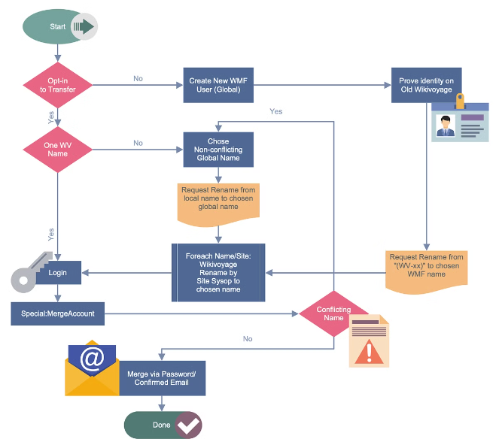
Workflow
1. Submission
Users submit new applications through the application submission module.
2. Review
Reviewers receive notifications and review the submitted applications.
3. Feedback
Reviewers provide feedback and either approve or reject the applications.
4. Notification
Users receive notifications about the status of their applications.
5. Tracking
Users can track the status of their applications through the status module.
6. Feedback Submission
Users can provide feedback on the process and the seminars they attend.

Slide 11


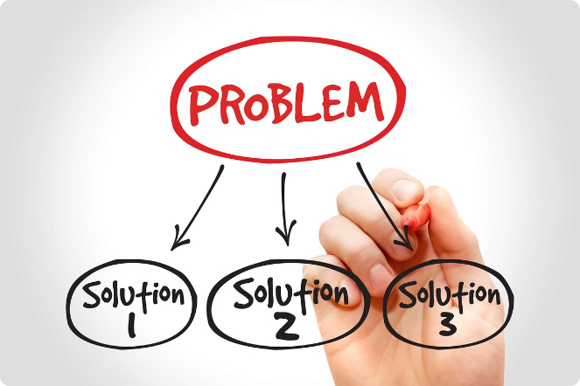


Challenges and Solutions
User Interface Design
Ensuring a user-friendly interface that meets the needs of diverse users can be challenging. Different users may have varying levels of technical proficiency and preferences for interface design.
Database Management
Efficiently managing a large volume of data while ensuring data integrity (accuracy and consistency) poses challenges. Performance issues can arise if queries are not optimized or if the database schema is not well-designed.
Security
Protecting user data and ensuring secure access to the system are critical. Security threats such as unauthorized access, data breaches, and malware attacks are significant concerns that need to be addressed.

Slide 12


Solutions
1
Iterative Design Process
Use an iterative design process to continuously improve the user interface based on user feedback. Conduct usability testing and gather user input to refine interface elements, navigation flows, and overall user experience.
2
Optimized Queries
Optimize database queries to improve performance and reduce database load. Regularly review and optimize database schema for better efficiency.
3
Security Measures
Implement robust security measures such as data encryption, secure authentication mechanisms (e.g., multi-factor authentication), and role-based access controls (RBAC). Conduct regular security audits and updates to address vulnerabilities and ensure compliance with security standards.

Slide 13


Results and Observations
Improved Efficiency
The implementation of Online HRD has streamlined the process of managing seminar applications, reducing the manual effort and time previously required.
Enhanced Transparency
Users have noted a significant improvement in transparency throughout the application process. With the introduction of a user-friendly dashboard, employees can now easily submit their applications and track the progress in real-time.
Positive Feedback
Feedback from users has been overwhelmingly positive, particularly regarding the system's user interface and efficiency. Employees appreciate the intuitive design of the application submission form and dashboard, which simplifies the process of submitting seminar applications.

Slide 14

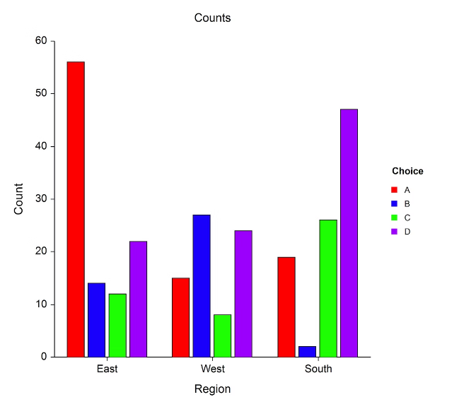
Operational Impact
Operational Impact
Description
Centralized Application Management
The system has centralized application management, minimizing errors and delays.
Standardized Approval Workflows
Standardized approval workflows have improved efficiency and reduced ambiguity.
Comprehensive Reporting and Analytics
HR administrators now have access to comprehensive reporting and analytics, facilitating informed decision-making and resource allocation for future seminars and training events.

Slide 15





Future Directions
Advanced Analytics and Reporting
Implement machine learning algorithms to analyze historical data and predict future trends in seminar attendance and employee participation.
Integration with Existing Systems
Integrate Online HRD with the existing Human Resource Management System (HRMS) to facilitate seamless data exchange.
Enhanced User Experience
Develop a mobile application or enhance the existing web interface to ensure that users can access Online HRD from any device, including smartphones and tablets.
Feedback and Continuous Improvement
Incorporate sentiment analysis and text mining techniques to analyze feedback submitted by conference attendees.
Scalability and Performance
Migrate to a cloud-based infrastructure to enhance scalability, reliability, and performance.
Security and Compliance
Implement advanced security protocols, including encryption, multi-factor authentication, and regular security audits, to protect sensitive employee data and ensure compliance with data protection regulations such as GDPR and CCPA.

Slide 16


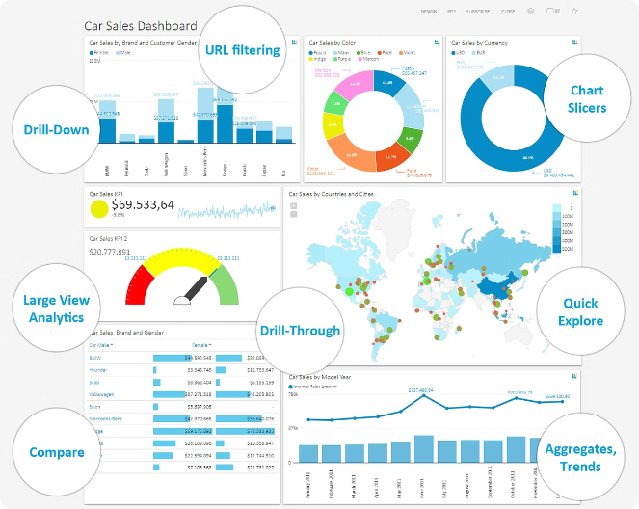


Advanced Analytics and Reporting
Predictive Analytics
Implement machine learning algorithms to analyze historical data and predict future trends in seminar attendance and employee participation.
Customizable Reports
Enhancing the reporting module to allow HR staff to create and customize reports based on various parameters such as date ranges, course names, and department-specific data.
Real-Time Dashboards
Developing real-time dashboards with interactive visualizations to monitor key performance indicators (KPIs) and seminar metrics.

Slide 17

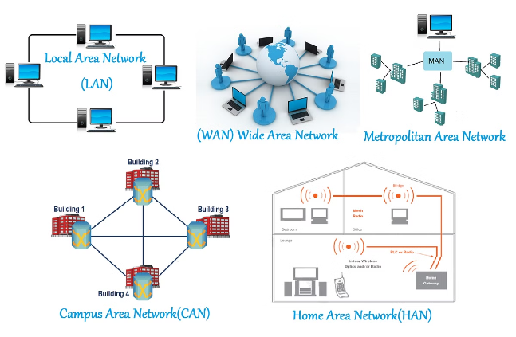
Integration with Existing Systems
1
HRMS Integration
Integrate Online HRD with the existing Human Resource Management System (HRMS) to facilitate seamless data exchange.
2
Third-Party System Integration
Exploring partnerships with third-party platforms and services to enhance functionality, such as integrating with Learning Management Systems (LMS) for a seamless learning experience or incorporating video conferencing tools for virtual seminars.

Slide 18


Conclusion
The implementation of Online HRD represents a significant milestone in enhancing the efficiency and transparency of seminar application management within our organization's HR division. Through meticulous planning, development, and deployment, Online HRD has successfully addressed key challenges associated with manual application processes, delivering tangible benefits and positive outcomes.

